Slide 1
Storytelling Case Study: Airbnb, NYC
By Sandeep Suman Pradhan

Slide 2
Introduction
Airbnb is an online platform where people can rent their unused spaces.
During the covid time, Airbnb incurred a huge loss in revenue.
People have started travelling again and Airbnb is aiming to bring up the business again

Slide 3
Preamble
For the past few months, Airbnb has seen a major decline in revenue.
Now that the restrictions have started lifting and people have started to travel more, Airbnb wants to make sure that it is fully prepared for this change.
So, analysis has been done on a dataset consisting of various Airbnb listings in New York.

Slide 4
Data Preparation
Data was cleaned with removal of duplicates and missing values
Unessential columns were dropped
Outliers were identified

Slide 5
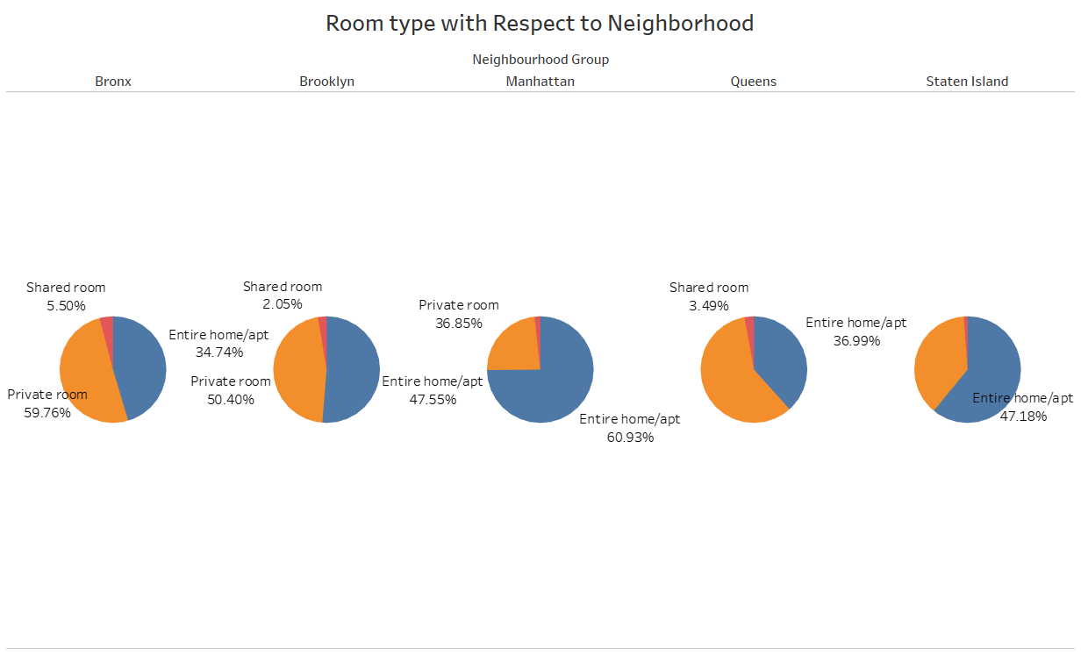
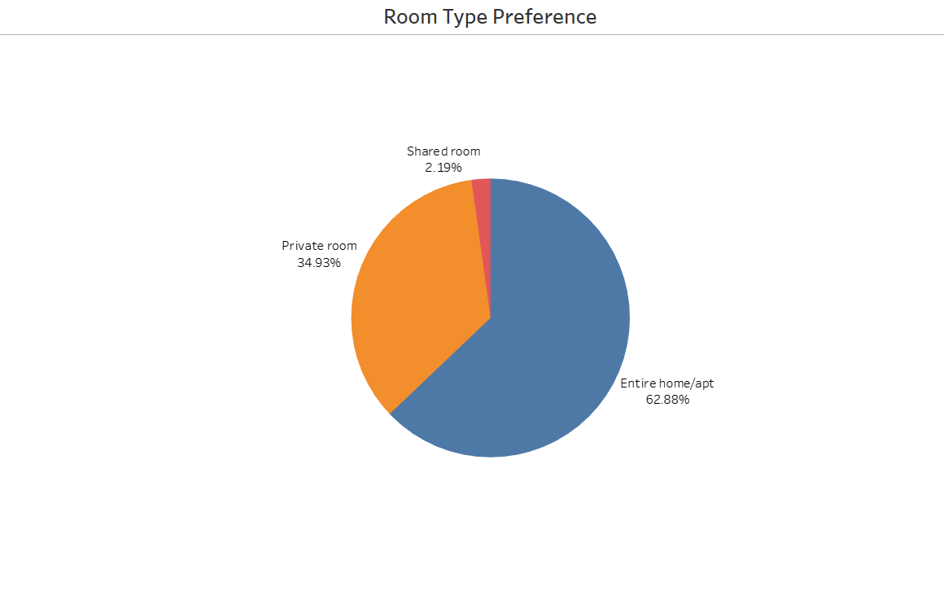
Room Type with respect to Neighborhood

Slide 6
Room Type with respect to Neighborhood Contd.
Manhattan and Brooklyn are top neighbourhood groups and mostly people prefer to book the entire home or private room
Manhattan has highest number of home/apt properties, i.e. 60.93% of total listed properties.
Overall, customers appear to prefer private rooms (34.93%) or entire homes (62.88%) in comparison to shared rooms (2.19%).
Maximum number of private rooms are available in Bronx i.e. around 59.76% of total listed properties.
Very less number of shared rooms are available in each Neighbourhood group.

Slide 7
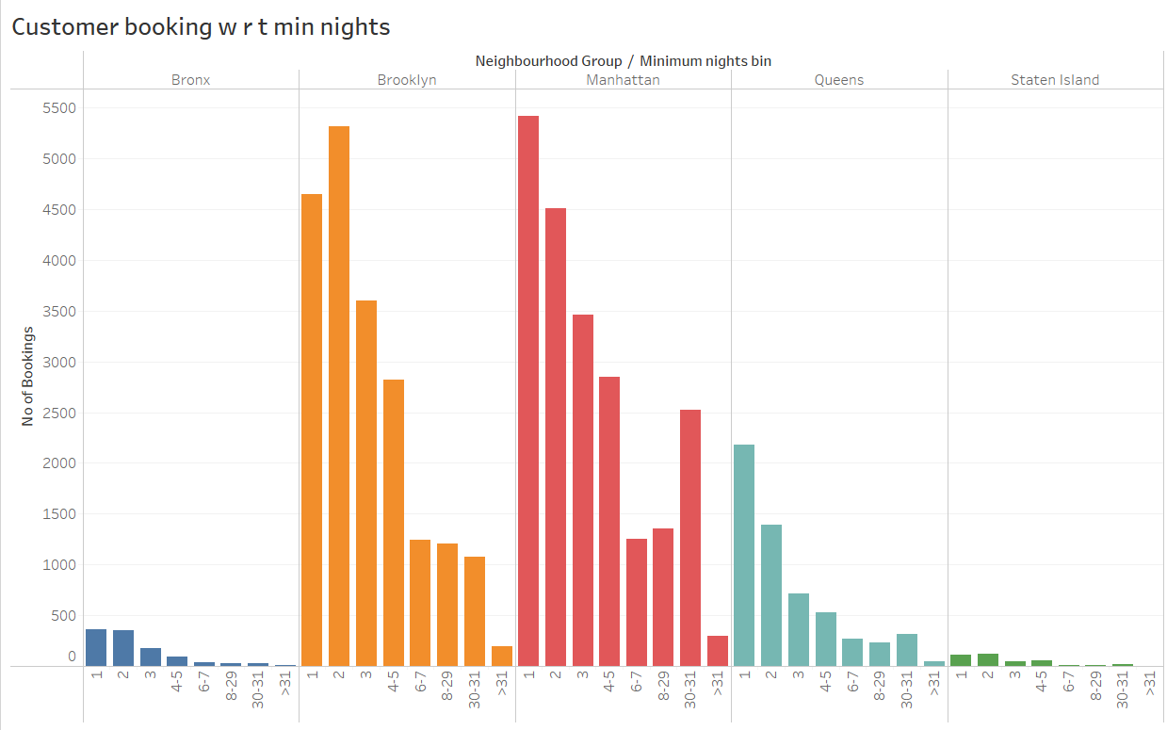
Room Type with respect to Neighborhood Contd.
The listings with Minimum nights 1-5 have the
most number of bookings.
We can see a prominent spike in 30 days, this would be
because customers would rent out on a monthly basis.
Manhattan &Queens have higher number of 30 day bookings compared to the others. The reason could be either tourists booking long stays or mid-level employees who opt for budget bookings due company visits

Slide 8
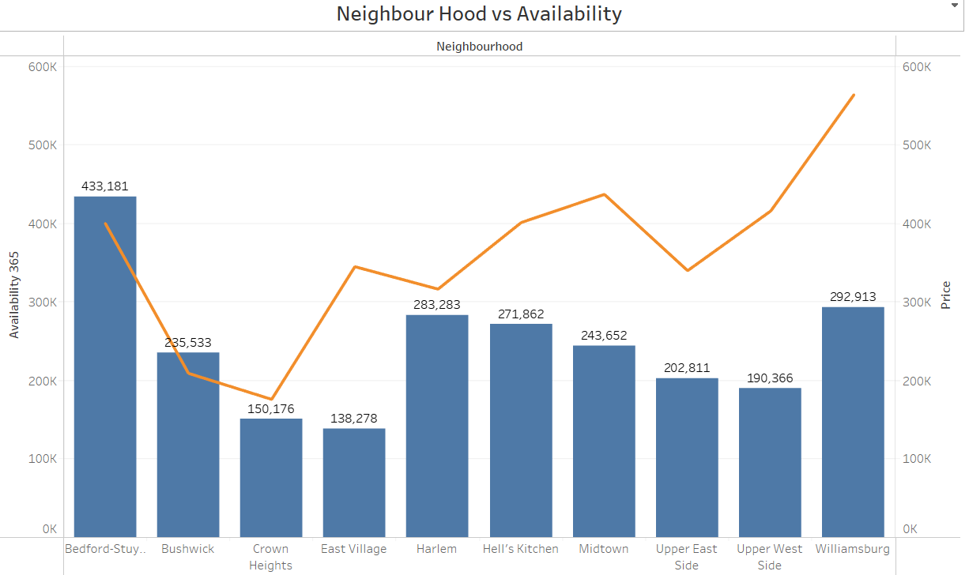
Neighborhood vs Availability
Availability of Bedford stuy is highest and its price is on the moderate side. It is a good choice for customers.
The price of Crown Heights is the lowest however availability is also low
The price of Williams burg is the highest

Slide 9
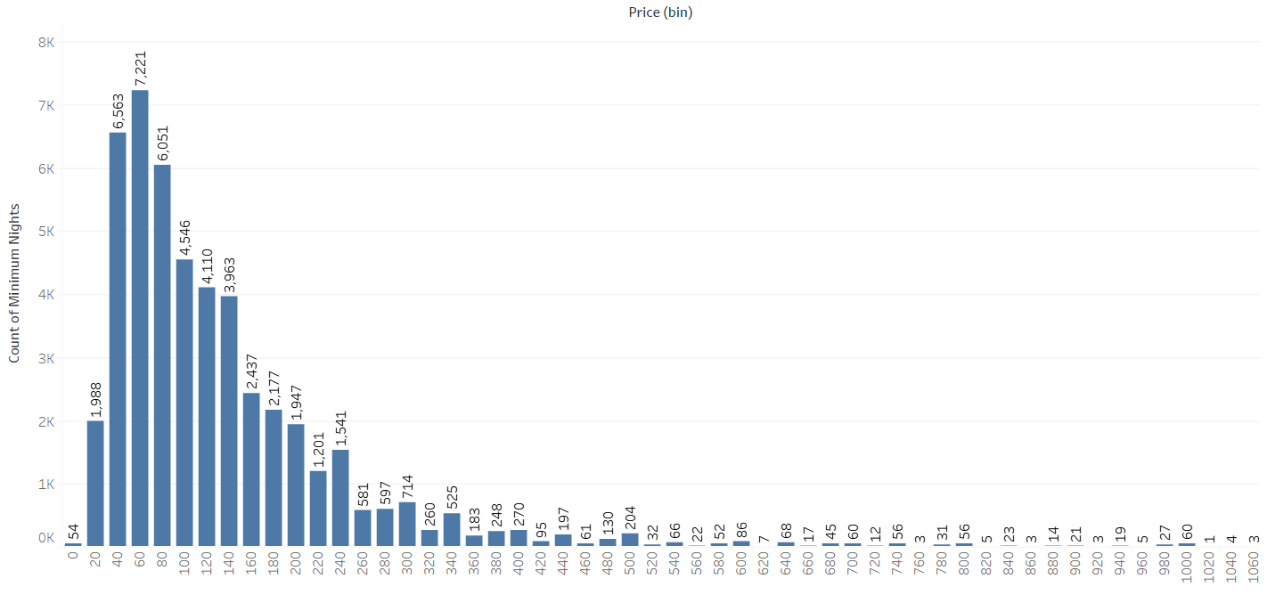
Neighborhood vs Availability
We have taken pricing preference based on volume of bookings done in a price range.
From both the graphs, the favourable price range is $40 - $200. This is the price range most preferred by most customers.

Slide 10
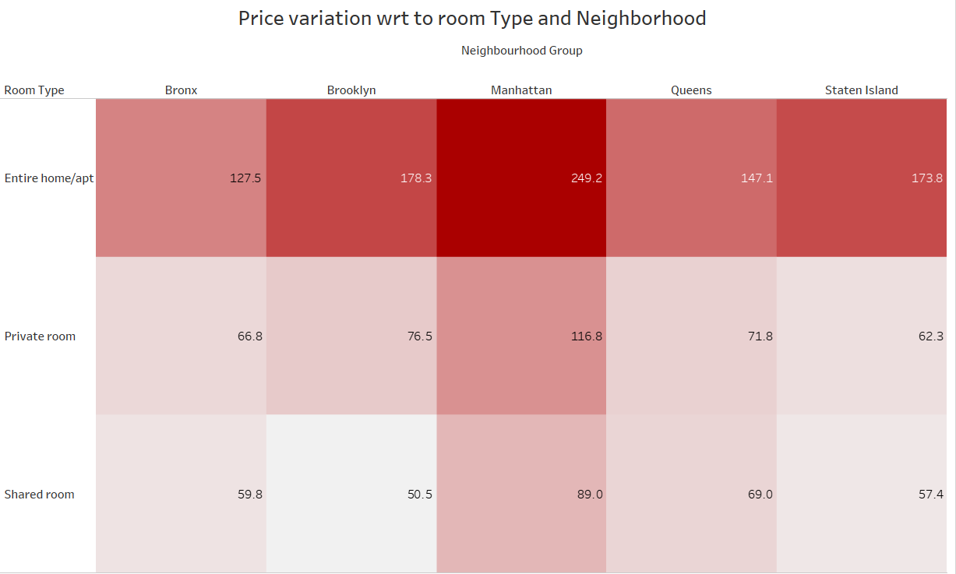
Price variation wrt to room type and Neighborhood
The 'Entire home/apt' room type in Manhattan is the most expensive at $250, much higher than the overall average.
‘private rooms’ of Manhattan & Brooklyn has the highest average.
‘Shared Room' type is the cheapest in Brooklyn with $50.5.

Slide 11
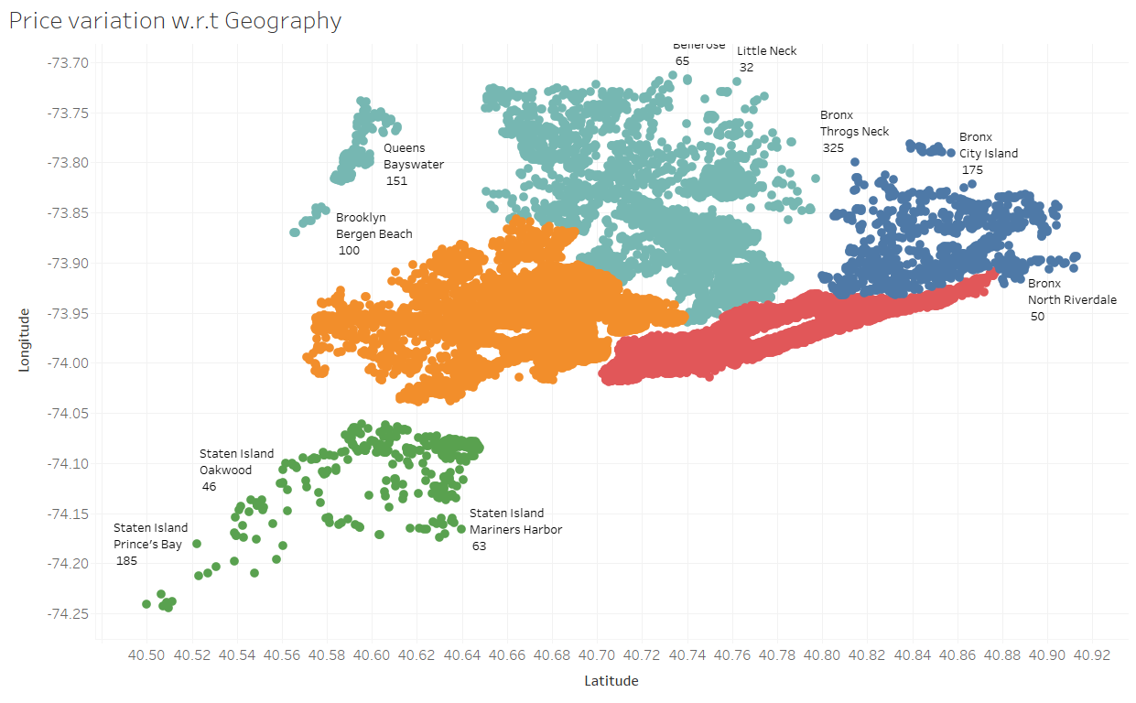
Price variation wrt to room type and Neighborhood
We see that, Airbnb has good presence in Manhattan, Brooklyn & Queens.
Listings are maximum in Manhattan & Brooklyn owing to the high population density and it being the financial and tourism hub of NYC. Staten Island has the least number of listings, due to its low population density and very few tourism destinations.

Slide 12
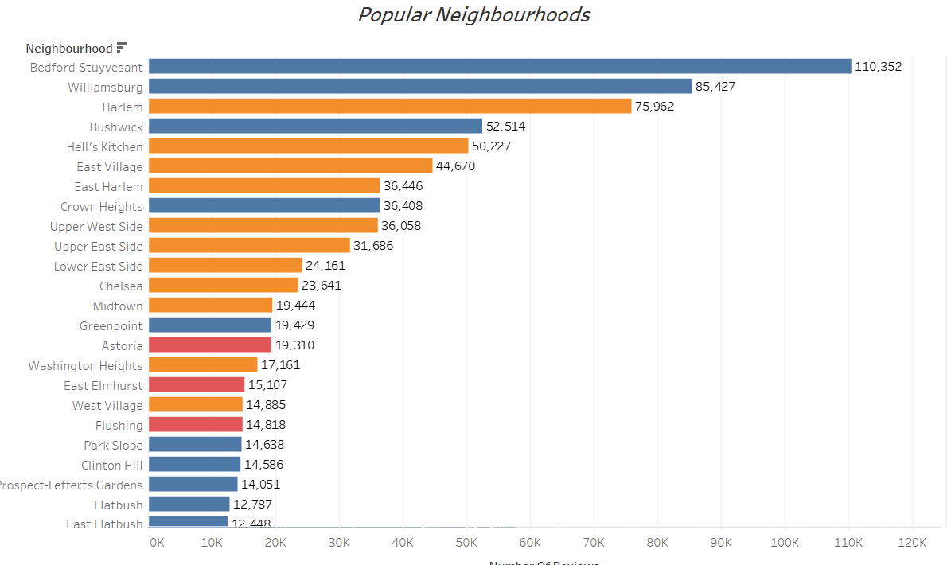
Price variation wrt to room type and Neighborhood
We see that Bedford-Stuyvesant from Brooklyn is the highest popular with 1,10,352 no of reviews in total followed by Williamsburg.
Harlem from Manhattan got the highest no of reviews followed by Hell’s kitchen.
The higher number of customer reviews imply higher satisfaction in these localities.

